Slide 1
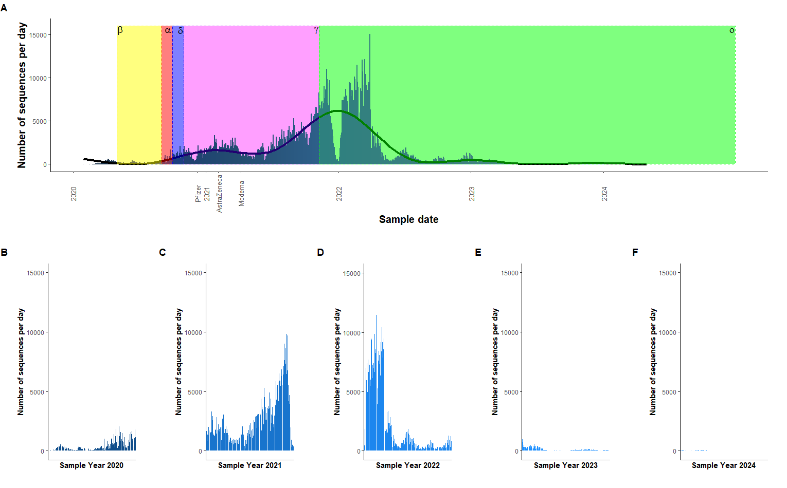
Figure 1. The number of sequences per day from 2020 – 2024. A The overall the number of sequences per day from years 2020 – 2024. The coloured zones represent the emergence of a new strain of SARS-CoV-2. Yellow – beta, red – alpha, purple – delta, pink – gamma, green - omicron. Also on the plot are specific dates showing the first use of that vaccine. A generalised linear model has been used. B The number of sequences per day for 2020. C The number of sequences per day for 2021. D The number of sequences per day for 2022. E The number of sequences per day for 2023. E The number of sequences per day for 2023. F The number of sequences per day for 2024.

